Slide 1
Growth of Single Crystal Thin Films

Slide 2
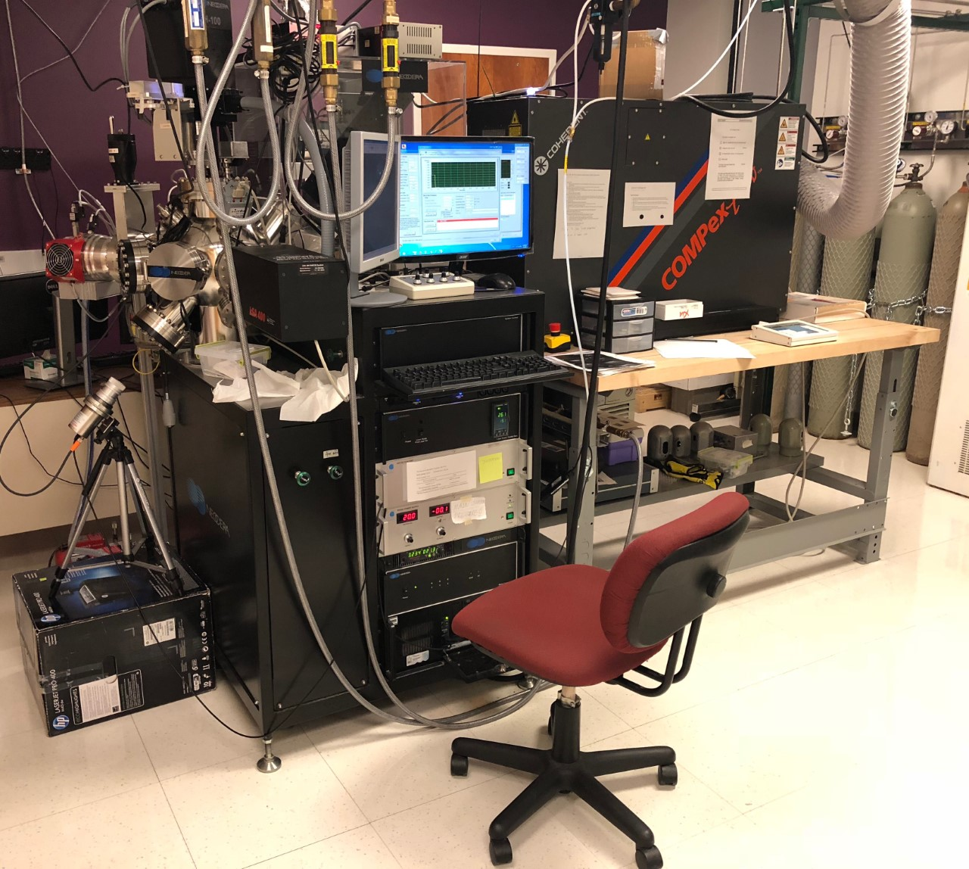
Thin Films
Physical properties
Lattice arrangement
Tailor properties
Manipulating crystal structure
Implementation

Slide 3
Pulsed laser deposition (PLD)
Laser Guiding System
Convex Lens
Laser Cavity
Plasma
- Electrode
+ Electrode
Chamber

Slide 4
Strain Engineering
Substrate lattice
Inconel

Slide 5
Strain Engineering
Substrate lattice
Inconel

Slide 6
Strain Engineering
Substrate lattice
Inconel

Slide 7
Credits
Created by Jonathan Gerdes
Taught by Xiaoshan Xu, Kishan Sinha, Corbyn Mellinger

