Slide 1
Optical band gaps from tetrahedral cation vacancy and variation of cation ordering in NCO films
Weiwei Zhao

Slide 2
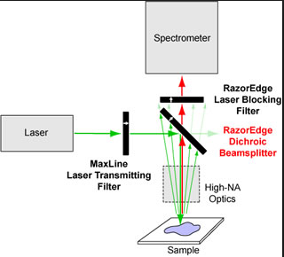
Raman spectroscopy
Raman spectroscopy is an effective tool for studying the
local structure of transition metal oxides, in particular, the
cation distribution, charge and orbital ordering, effects of
phase transition

Slide 3
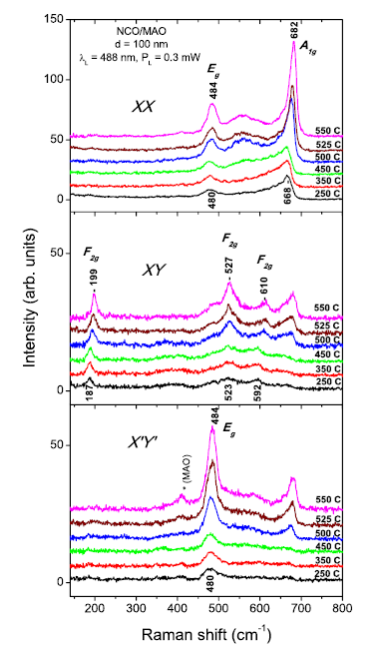
X, Y, X’, and Y’ denote the [100], [010], [110], and [-110] directions of the MAO substrate
The first and second letter in the double notations XX, XY, X’X’, and X’Y’ for the scattering configuration correspond to the direction of incident and scattered light polarization
it provides an unambiguous Raman evidence that all six NCO films are epitaxial and the crystallographic directions coincide with those of the MAO substrate.

Slide 4
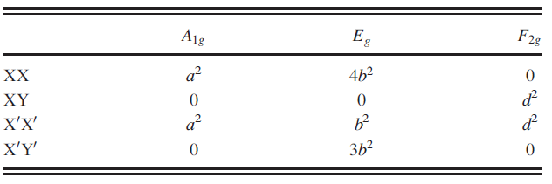
Raman active phonon modes (A1g + Eg + 3F2g) of the ideal
spinel structure.

Slide 5
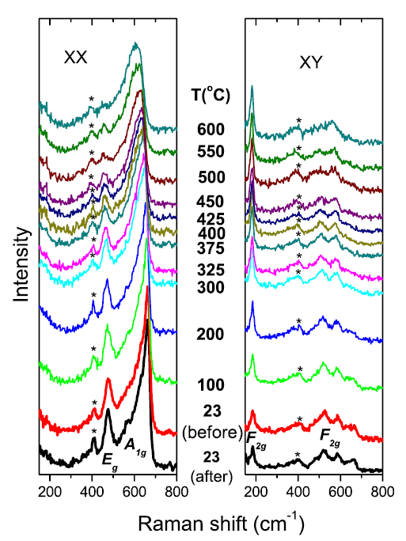
The variations of the Raman spectra of NCO250 with increasing temperature between 23 and 600 C in air and at 23 C after the thermal treatment.
The film grown at Tsub = 550 C has a structure close to that of the ideal inverse spinel
Those deposited at lower Tsub are likely characterized by mixed cation/charge distribution at both tetragonal (A) and octahedral (B) sites

Slide 6
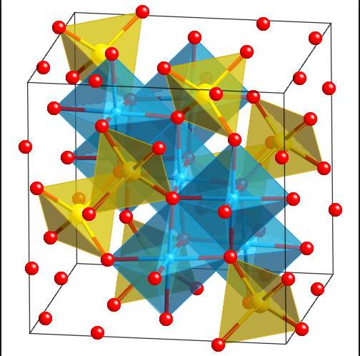
Cation distribution
(a) various percentage of structural inversion
(b) consideration of A site cation vacancy defects

Slide 7
Experimental techniques
High resolution electron energy loss spectroscopy (HREELS) is utilized to probe the optical band gaps at the nanoscale in epitaxial NiCo2O4 (NCO) thin films with different structural order (cation/charge).
modified Becke–Johnson exchange potential + local density approximation (LDA) correlation (mBJLDA) is a density functional theory
Electronic structure simulations were performed using WIEN2k based density functional theory calculations on the relaxed 14 atoms NCO unit cells.
HRTEM can display these areas clearly and thus provides a unique opportunity to directly acquire low loss spectra locally with high signal intensity

Slide 8
Experimental details
The NCO films were grown on (1 0 0)-oriented MgAl2O4 (MAO) substrates by pulsed laser deposition technique at three different temperatures i.e., 250, 350 and 550 ◦C
HREELS measurements for the NCO samples were performed at two different temperatures, i.e. 90 and 300 K.
Electronic structure calculations were performed for six different configurations

Slide 9
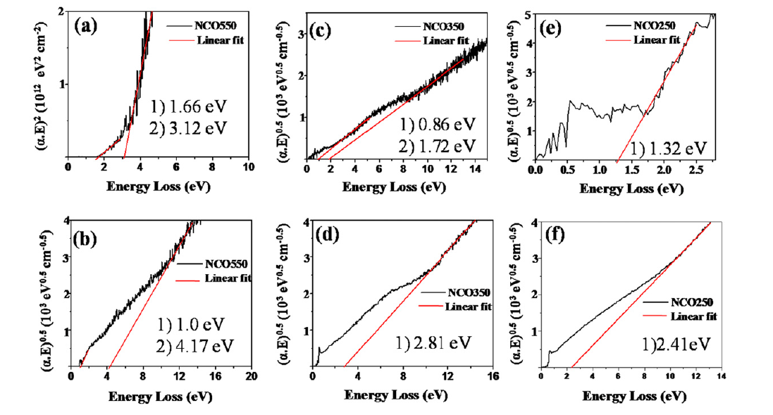
Cation distribution

Slide 10
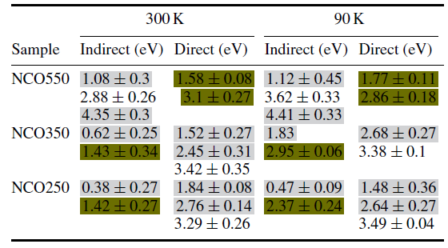
Experimental band gap values
The values marked with the light colour are the band edge absorption from A site vacancy regions
deep colour are from the non-defective areas
the values without colour marks are the inter band transitions.

Slide 11
Six configuration
(a) the ferrimagnetic inverse spinel structure (resulting magnetic moment of 2 μB/f.u)
(b) the non-magnetic inverse spinel structure (magnetic moment was forced to 0 μB/f.u.)
(c) the normal spinel structure (magnetic moment of 2 μB/f.u.),
(d) with a mixed spinel-inverse spinel structure where 25 and 50% of the A site Co atoms are swapped with B site Ni atoms (magnetic moment 2 μB/f.u.)
(e) inverse spinel with 50% of A site atoms removed (magnetic moment of 1.5 μB/f.u.)
(f) all A site atoms are removed from the unit cell

Slide 12
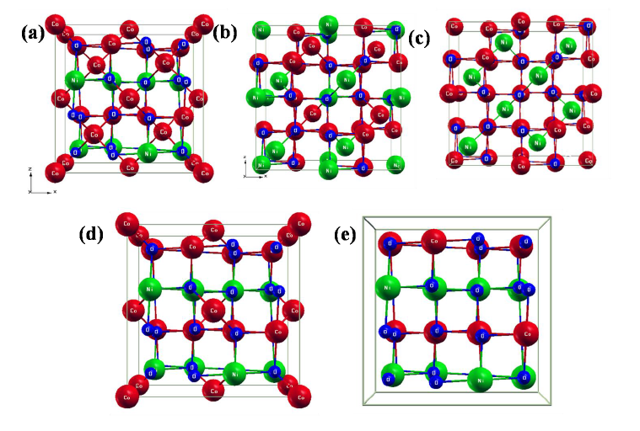
Electronic structure simulation

Slide 13
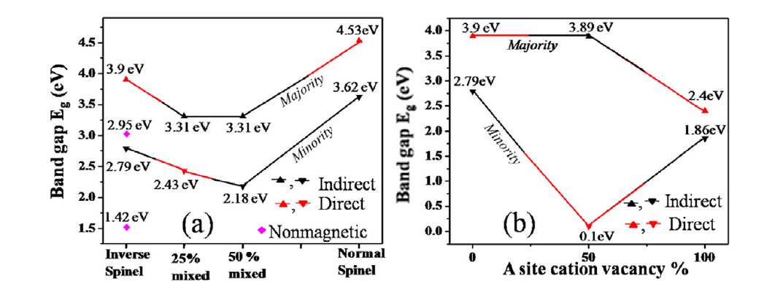
band gap values and their types
(a) various percentage of structural inversion
(b) consideration of A site cation vacancy defects

Slide 14
Thanks!

