Slide 1
Interconversion between iron Oxides
Xiaozhe Zhang
09/21/2014

Slide 2
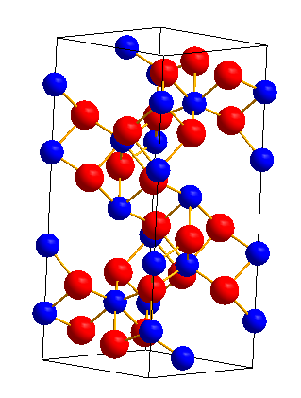
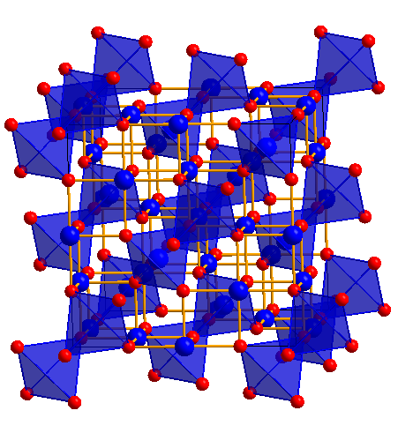
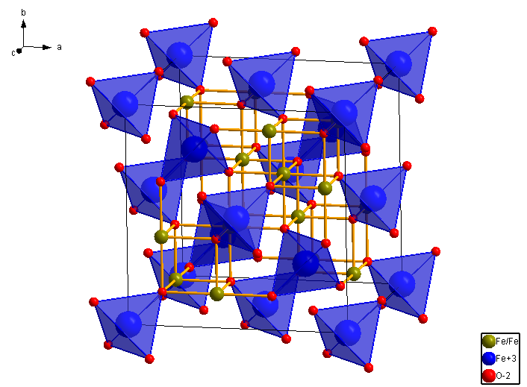
Structures of Iron Oxides
α-Fe₂O₃
γ-Fe₂O₃
Fe₃O₄
 | α-Fe₂O₃ | γ-Fe₂O₃ | Fe₃O₄
Space group | R-3c (167) | Fd-3m (227) | Fd-3m (227)
Lattice constants | 5.0079 (A) | 8.3300 (A) | 8.384 (A)

Slide 3
The interconversion of iron oxides
Structrue change, T (IV)
γ-Fe₂O₃
α-Fe₂O₃
Oxidize(II), O2
Oxidize(III), O2
Reduce (I)
H2, thermal reduction
Fe₃O₄
α-Fe₂O₃ = 2/3 Fe₃O₄ + 1/6 O₂ (I)
Fe₃O₄ + 1/4 O₂ = 3/2 α-Fe₂O₃ (II)
Fe₃O₄ + 1/4 O₂ = 3/2 γ-Fe₂O₃ (II)
γ-Fe₂O₃ = α-Fe₂O₃ (IV)

Slide 4
Interconversion in between of α‑Fe₂O₃ and Fe₃O₄
FeO on Pt(111)
Fe3O4 film
α-Fe2O3 with structure
Fe3O4 and α-Fe2O3
Crystal structures of FeO, wüstite (a), Fe₃O₄, magnetite (b), and α-Fe₂O₃, hematite (c).
LEED patterns of the surface structures
J. Phys. Chem. C 2014, 118, 29068−29076

Slide 5
Interconversion in between different phase of Fe₂O₃
Chem. Mater. 2011, 23, 3255–3272

Slide 6
Interconversion in between of α‑Fe₂O₃ and γ-Fe₂O₃
ACTA PHYSICA POLONICA A, 125 (2014)

Slide 7
Interconversion in between of α‑Fe₂O₃ and Fe₃O₄
Fe(110)
Fe(110)
300 K
Fe₂O₃(0001)
450 K
600 K
FeO(111)
Fe₃O₄(111)
FeO
Fe₃O₄
800 K
FeO
UPS
Fe₃O₄
Langmuir 2011, 27(1), 11–14

Slide 8
Summary
Describe the phase transition with different method, like XRD, XPS, LEED.
Lack of theoretic analysis
In our experiment:
Real time RHEED study of phase transition.
Thermodynamic analysis
hetero-multilayer growth of iron oxides.
Al₂O₃/α-Fe₂O₃, Al₂O₃/Fe₃O₄, Al₂O₃/Fe₃O₄/γ-Fe₂O₃, Al₂O₃/Fe₃O₄/ α- and γ-Fe₂O₃ biphase

