Slide 1
The properties of NCO film grown on the MAO substrate
Weiwei Zhao
8/28/2015

Slide 2
Outline
Relationship between growth temperature and resistivity
Relationship between thickness and resistivity
Dielectric constant measurement
Cation distribution and thermal stability of NCO
What’s the next work

Slide 3
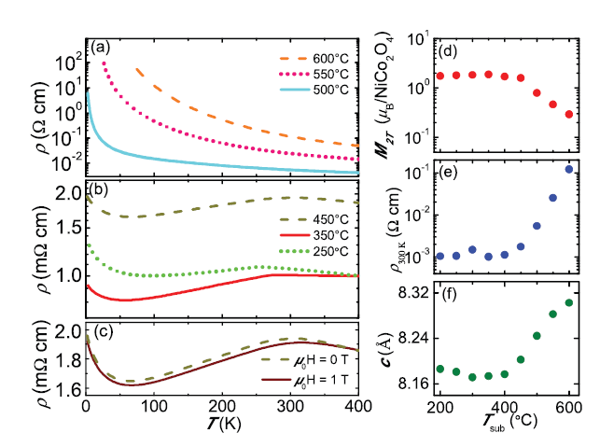
growth temperature dependence
resistivity ρ vs. temperature T for the NiCo2O4 grown at 250°C , 350°C, 450°C, 500°C, 550°C, 600°C

Slide 4
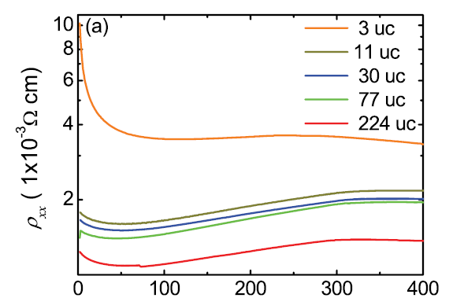
Thickness dependence
In-plane resistivity ρ vs. temperature T for the NiCo2O4 with the thicknesses of 3, 11, 30, 77, and 224 unit cellsc

Slide 5
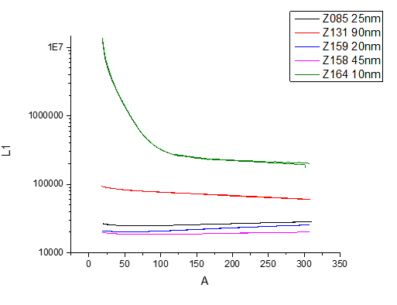
Our result

Slide 6
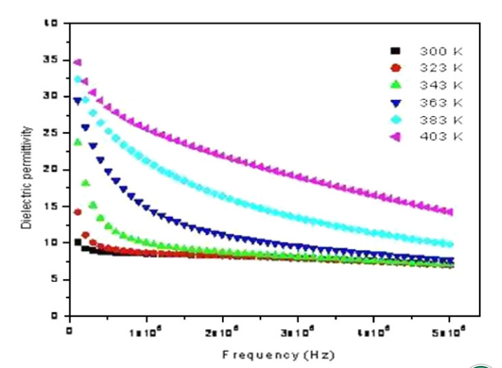
Dielectric constant
dielectric constant with frequency at different temperatures

Slide 7
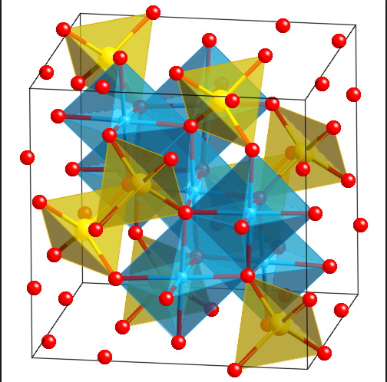

Cation distribution
tetragonal (A-site) positions occupied by mostly ${Co}^{+3}$
octahedral (B-site) positions occupied by nearly equal concentrations of ${Ni}^{+2}$ and ${Co}^{+3}$

Slide 8
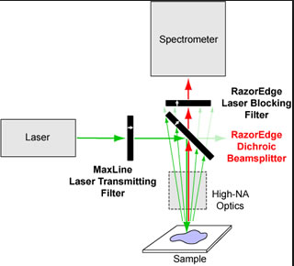
Raman spectroscopy
Raman spectroscopy is an effective tool for studying the
local structure of transition metal oxides, in particular, the
cation distribution, charge and orbital ordering, effects of
phase transition

Slide 9
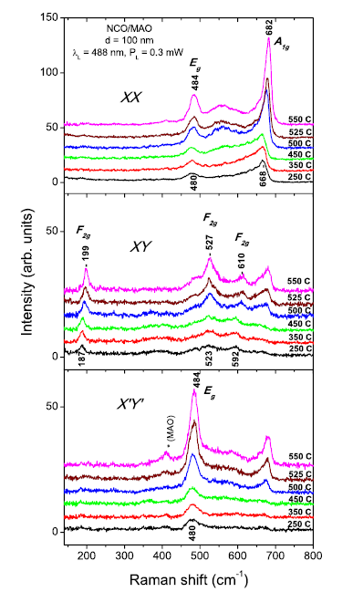
X, Y, X’, and Y’ denote the [100], [010], [110], and [-110] directions of the MAO substrate
The first and second letter in the double notations XX, XY, X’X’, and X’Y’ for the scattering configuration correspond to the direction of incident and scattered light polarization
it provides an unambiguous Raman evidence that all six NCO films are epitaxial and the crystallographic directions coincide with those of the MAO substrate.

Slide 10
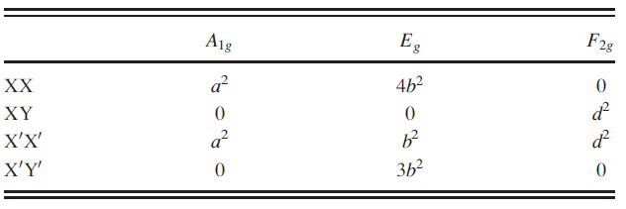
Raman active phonon modes (A1g + Eg + 3F2g) of the ideal
spinel structure.

Slide 11
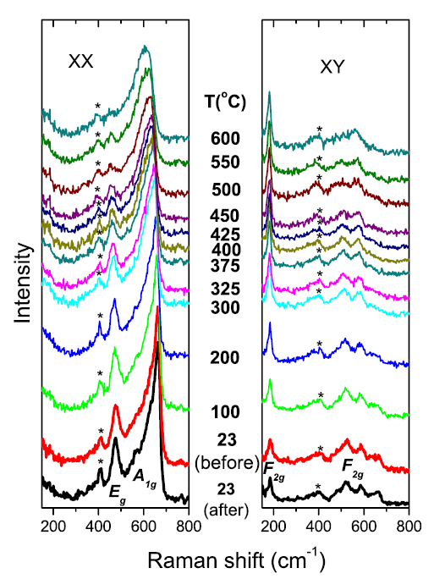
The variations of the Raman spectra of NCO250 with increasing temperature between 23 and 600 C in air and at 23 C after the thermal treatment.
The film grown at Tsub ?550 C has a structure close to that of the ideal inverse spinel
Those deposited at lower Tsub are likely characterized by mixed cation/charge distribution at both tetragonal (A) and octahedral (B) sites

Slide 12
Next work
Go on studying the thickness dependence of films grown at different temperature
Dielectric constant of NCO

Slide 13
Thank you!

